Slide 1
Lecture 3-Module 1
Functions and Exceptions

Slide 2
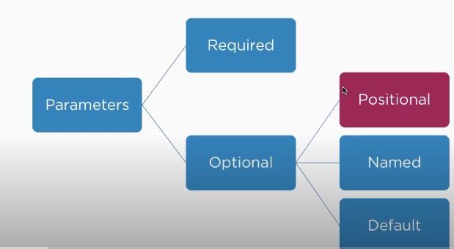
Optional Positional Parameters in Functions

Slide 3
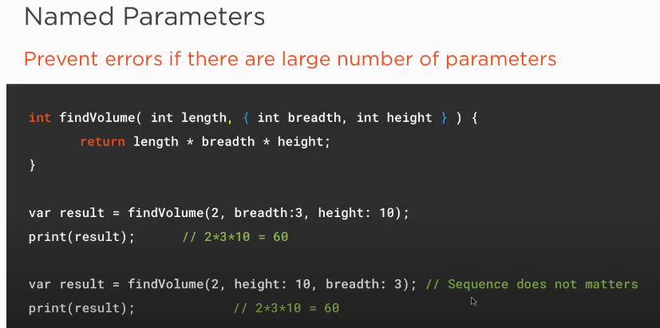

Slide 4
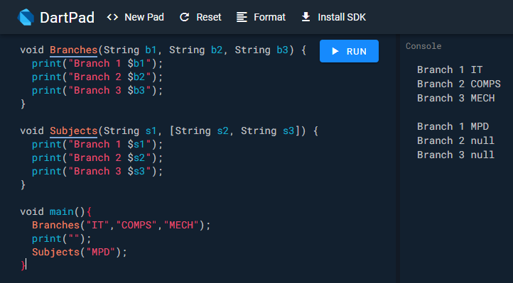
Required and positional parameters

Slide 5
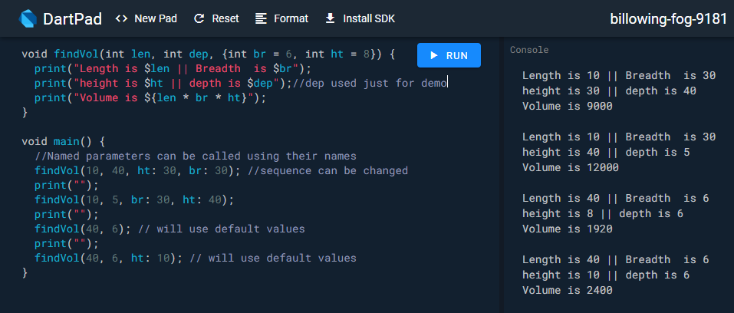
named and default parameters

Slide 6
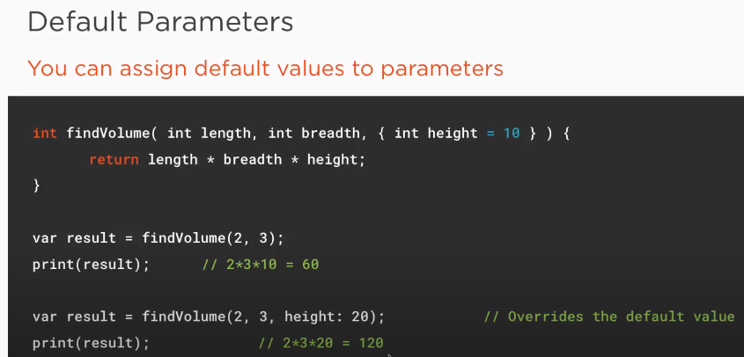

Slide 7
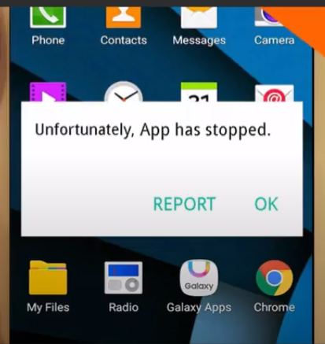
Exception Handling
When normal flow of Execution is disrupted and App Crashes.
Exceptions can be handled using following clauses to avoid app crash
try
on
catch
Finally
Custom exceptions

Slide 8
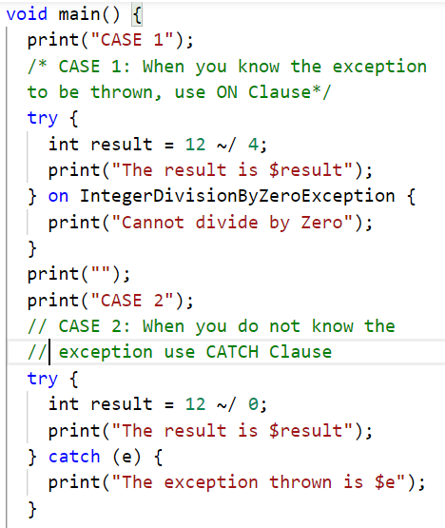
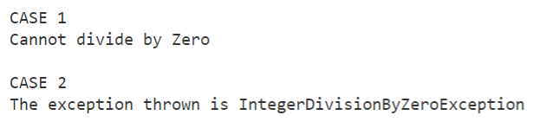
try and on clause
When you know the exception to be thrown, use “on” Clause
Use “catch” clause when exception type is not known

Slide 9
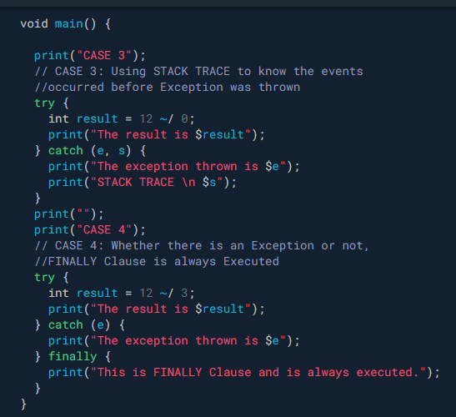
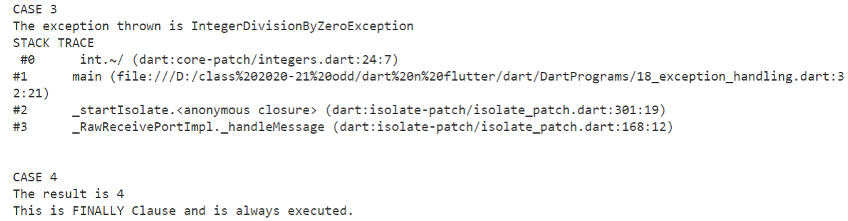
stacktrace and finally

Slide 10
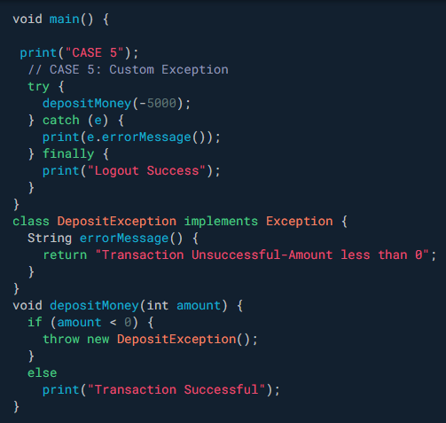
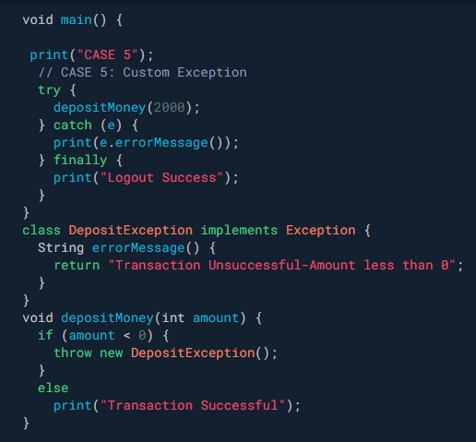


User defined /custom exceptions

Slide 11
Imports
// Importing core libraries
import 'dart:math';
// Importing libraries from external packages
import 'package:test/test.dart';
// Importing files
import 'path/to/my_other_file.dart';

Slide 12
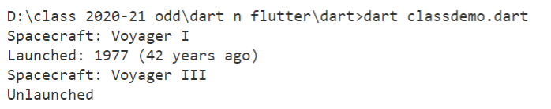
class
class Spacecraft {
String name;
DateTime launchDate;
// Constructor, with syntactic sugar for assignment to members.
Spacecraft(this.name, this.launchDate) {
// Initialization code goes here.
}
// Named constructor that forwards to the default one.
Spacecraft.unlaunched(String name) : this(name, null);
int get launchYear => launchDate?.year; // read-only non-final property
// Method.
void describe() {
print('Spacecraft: $name');
if (launchDate != null) {
int years = DateTime.now().difference(launchDate).inDays ~/ 365;
print('Launched: $launchYear ($years years ago)');
} else {
print('Unlaunched');
}
}
}
main() {
var voyager =
Spacecraft('Voyager I', DateTime(1977, 9, 5));
voyager.describe();
var voyager3 = Spacecraft.unlaunched('Voyager III');
voyager3.describe();
}

Slide 13
Task 2-Practice Problem
WAP for banking apps with functions -Withdrawal ,Deposit, BalanceCheck functionality. Make use of attributes ex.- Account no., customer name ,account balance, amount to be deposited and withdrawal .Make use of default ,named parameters in the program.
If balance is less than withdrawal amount throw LessBalanceException (custom)
Withdrawal()
Deposit()
BalanceCheck()
NOTE:: what parameters should be passed to functions assume yourself ,should be relevant and display account balance after deposit and withdrawal (Take Static inputs for now check for exceptions ) Use concepts covered in the class

Slide 14
Dart References
https://dart.dev/samples#hello-world

